Slide 1
COMP 4500
Week 6 - Friday

Slide 2
Last time
What did we talk about last time?
Recurrence relations

Slide 3
Questions?

Slide 4
Assignment 3

Slide 5
Logical warmup
A man offers you a bet
He shows you three cards
  One is red on both sides
  One is green on both sides
  One is red on one side and green on the other
He will put one of the cards, at random, on the table, with a random side up
If you can guess the color on the other side, you win
If you bet $100
  You gain $60 on a win
  You lose your $100 on a loss
Should you take the bet? Why or why not?

Slide 6
Further Recurrence Relations

Slide 7
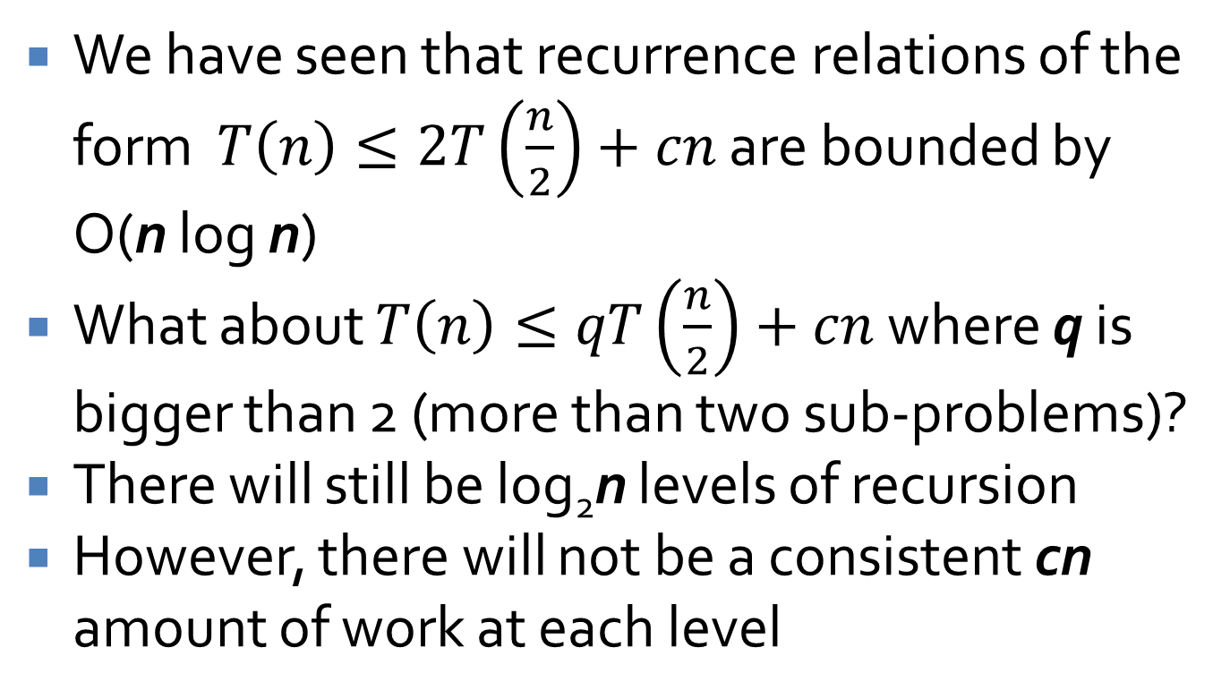
Further recurrence relations
We have seen that recurrence relations of the form $T\left(n\right)≤2T\left(\frac{n}{2}\right)+cn$ are bounded by O(n log n)
What about $T\left(n\right)≤qT\left(\frac{n}{2}\right)+cn$ where q is bigger than 2 (more than two sub-problems)?
There will still be log₂n levels of recursion
However, there will not be a consistent cn amount of work at each level

Slide 8
Consider q = 3
cn
cn
(3/2)cn
(9/4)cn
cn/2
cn/2
cn/2
cn/4
cn/4
cn/4
cn/4
cn/4
cn/4
cn/4
cn/4
cn/4

Slide 9
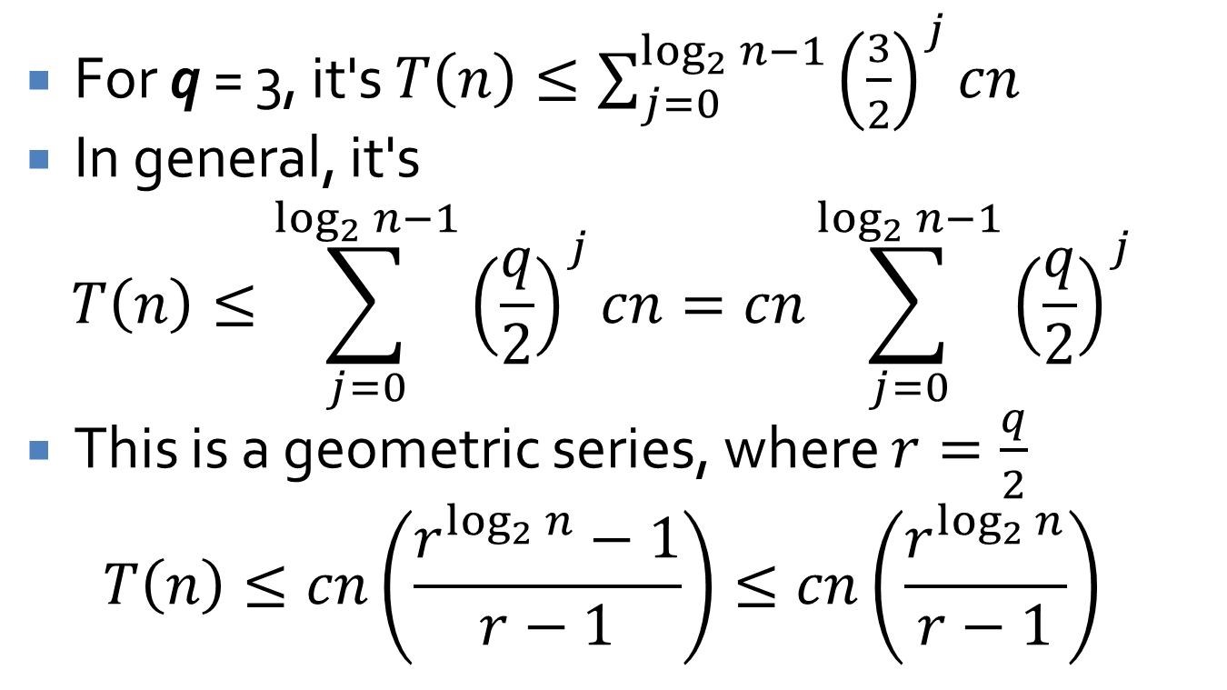
Converting to summation
For q = 3, it's $T\left(n\right)≤\sum_{j=0}^{\log_{2}{n−1}}{{\left(\frac{3}{2}\right)}^{j}cn}$
In general, it's
$$T\left(n\right)≤\sum_{j=0}^{\log_{2}{n−1}}{{\left(\frac{q}{2}\right)}^{j}cn}=cn\sum_{j=0}^{\log_{2}{n−1}}{{\left(\frac{q}{2}\right)}^{j}}$$
This is a geometric series, where $r=\frac{q}{2}$
$$T\left(n\right)≤cn\left(\frac{r^{\log_{2}{n}}−1}{r−1}\right)≤cn\left(\frac{r^{\log_{2}{n}}}{r−1}\right)$$

Slide 10
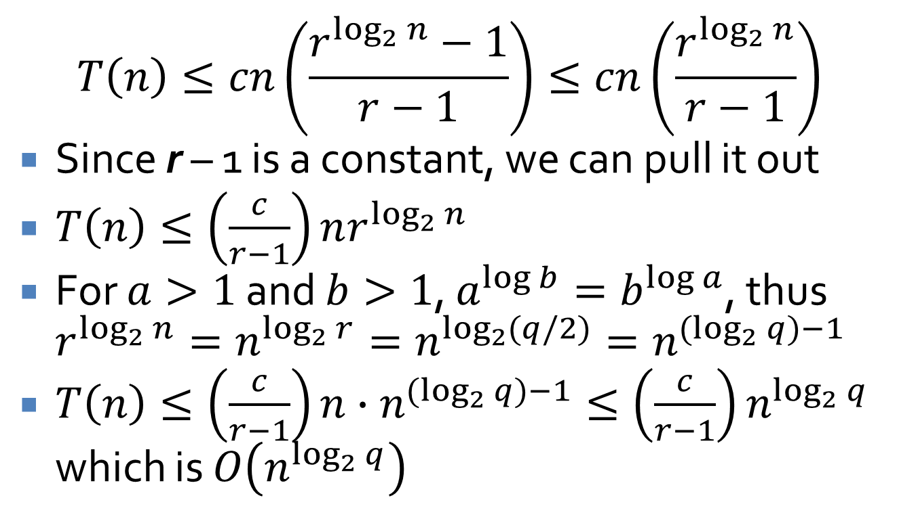
Final bound
$$T\left(n\right)≤cn\left(\frac{r^{\log_{2}{n}}−1}{r−1}\right)≤cn\left(\frac{r^{\log_{2}{n}}}{r−1}\right)$$
Since r – 1 is a constant, we can pull it out
$T\left(n\right)≤\left(\frac{c}{r−1}\right)nr^{\log_{2}{n}}$
For $a>1$ and $b>1$, $a^{\log{b}}=b^{\log{a}}$, thus $r^{\log_{2}{n}}=n^{\log_{2}{r}}=n^{\log_{2}{(q/2)}}=n^{(\log_{2}{q})−1}$
$T\left(n\right)≤\left(\frac{c}{r−1}\right)n∙n^{(\log_{2}{q})−1}≤\left(\frac{c}{r−1}\right)n^{\log_{2}{q}}$ which is $O\left(n^{\log_{2}{q}}\right)$

Slide 11
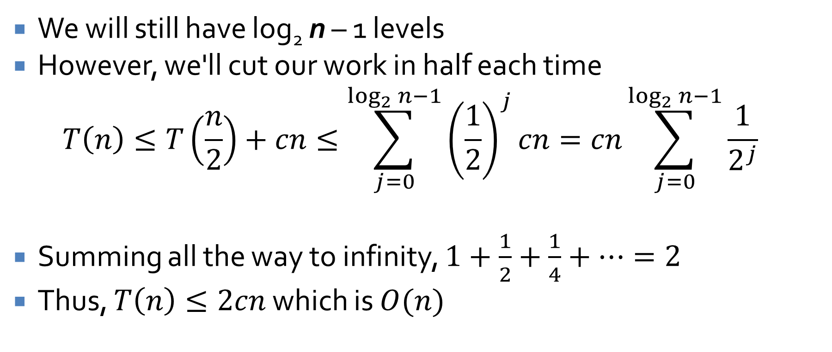
What about a single sub-problem?
We will still have log₂ n – 1 levels
However, we'll cut our work in half each time
$$T\left(n\right)≤T\left(\frac{n}{2}\right)+cn≤\sum_{j=0}^{\log_{2}{n−1}}{{\left(\frac{1}{2}\right)}^{j}cn}=cn\sum_{j=0}^{\log_{2}{n−1}}{\frac{1}{2^{j}}}$$
Summing all the way to infinity, $1+\frac{1}{2}+\frac{1}{4}+…=2$
Thus, $T\left(n\right)≤2cn$ which is $O(n)$

Slide 12
What might that look like in code?
Here's a non-recursive version in Java
We've just shown that this is O(n), in spite of the two for loops
int counter = 0;
for( int i = 1; i <= n; i *= 2 )
for( int j = 1; j <= i; j++ )
counter++;

Slide 13
Three-Sentence Summary of Counting Inversions

Slide 14
Counting Inversions

Slide 15
Rankings
Let's say that you like the following 2024 Oscar nominees in this order:
  American Fiction
  Barbie
  Oppenheimer
  Poor Things
The correct ordering is:
  Barbie
  Poor Things
  Oppenheimer
  American Fiction

Slide 16
Ranking similarity
What if we wanted to measure the similarity of your ranking to the given ranking?
Inversions are pairs of elements that are out of order in one ranking with respect to the other
Formally, for indices i < j, there's an inversion if ranking r_{i} > r_{j}

Slide 17
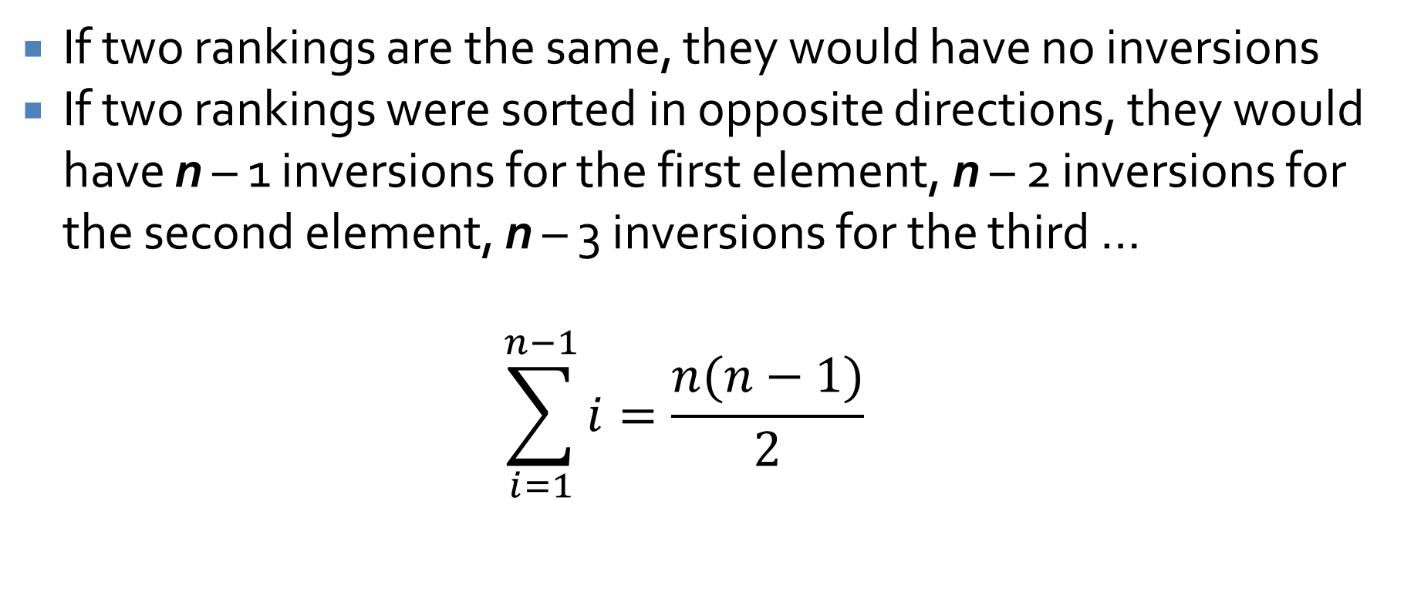
Minimum and maximum inversions
If two rankings are the same, they would have no inversions
If two rankings were sorted in opposite directions, they would have n – 1 inversions for the first element, n – 2 inversions for the second element, n – 3 inversions for the third …
$$\sum_{i=1}^{n−1}{i}=\frac{n(n−1)}{2}$$

Slide 18
Visualization of inversions
You can visualize inversions as the number of line segments crossings if you match up items in one list with the other
A total of 4 inversions
American Fiction
Barbie
Oppenheimer
Poor Things
Barbie
Poor Things
Oppenheimer
American Fiction

Slide 19
Getting the counting right
Since we're dealing with two different orders, it's sometimes hard to understand what we're supposed to be counting
American Fiction Other rank: 4
Barbie Other rank: 1
Oppenheimer Other rank: 3
Poor Things Other rank: 2
American Fiction contributes 3 (because 4 is bigger than 1, 3, and 2)
Barbie contributes 0
Oppenheimer contributes 1 (because 3 is bigger than 2)
The last one always contributes nothing

Slide 20
Example
Consider the following items whose rankings from another list are given
  9
  4
  2
  6
  1
  8
  7
  10
  3
  5
Count the inversions

Slide 21
Why do we care?
The process of collaborative filtering tries to match preferences of different people on the Internet
If your preferences are similar to someone else's, Netflix can recommend shows that they liked
Counting inversions is just one way to measure similarity between preferences

Slide 22
Algorithm design
Given a list of rankings, it's easy to count how many rankings are out of order with respect to the rankings that come after them
What's the problem with this algorithm?
It's O(n²)
int inversions = 0;
for (int i = 0; i < n - 1; ++i)
for (int j = i + 1; j < n; ++j)
if( rankings[i] > rankings[j] )
++inversions;

Slide 23
Can we do better?
Of course!
We can borrow from the Mergesort algorithm
Divide the problem in half
Then, we will get the number of inversions in the first half and in the second half
Are we done?
  No, we also have to count the inversions between the first half and the second half
  Those are exactly those elements in the first half that are bigger than elements from the second half
  We can find those during the merge process

Slide 24
Merge-and-Count(A, B)
Maintain a Current pointer into each list, initialized to point to the front elements
Set Count = 0
While both lists have elements
  Let a_{i} and b_{j} be the elements pointed to by the Current pointer
  Append the smaller one to the output list
  If b_{j} is smaller then
    Increment Count by the number of elements left in A
  Advance the Current pointer in the list that had the smaller element

Slide 25
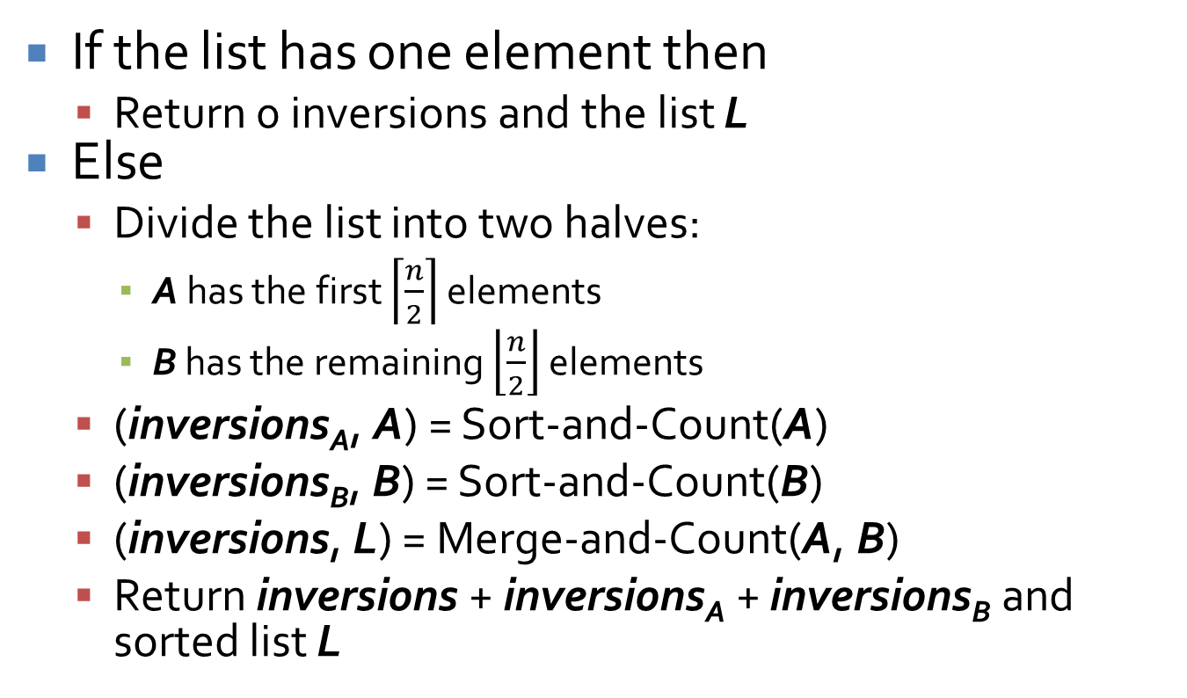
Sort-and-Count(L)
If the list has one element then
  Return 0 inversions and the list L
Else
  Divide the list into two halves:
    A has the first $\left\lceil \frac{n}{2}\right\rceil$ elements
    B has the remaining $\left\lfloor \frac{n}{2}\right\rfloor$ elements
  (inversions_{A}, A) = Sort-and-Count(A)
  (inversions_{B}, B) = Sort-and-Count(B)
  (inversions, L) = Merge-and-Count(A, B)
  Return inversions + inversions_{A} + inversions_{B} and sorted list L

Slide 26
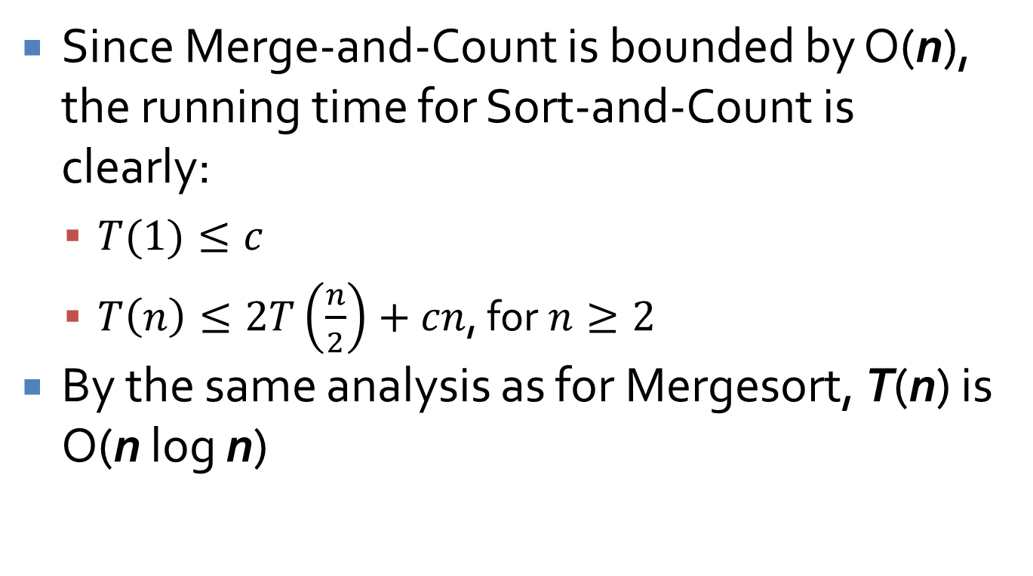
Running time
Since Merge-and-Count is bounded by O(n), the running time for Sort-and-Count is clearly:
  $T(1)≤c$
  $T\left(n\right)≤2T\left(\frac{n}{2}\right)+cn$, for $n≥2$
By the same analysis as for Mergesort, T(n) is O(n log n)

Slide 27
Upcoming

Slide 28
Next time…
Closest pair of points

Slide 29
Reminders
Assignment 3 is due tonight by midnight
Read section 5.4
Extra credit opportunities (0.5% each):
  Hristov teaching demo: 2/19 11:30-12:25 a.m. in Point 113
  Hristov research talk: 2/19 4:30-5:30 p.m. in Point 139

